Slide 1
Localstack - AWS resources on your local machine
Omri Ratson
Semantics, Illuminate

Slide 2
Localstack overview
Demo
Workshop

Slide 3
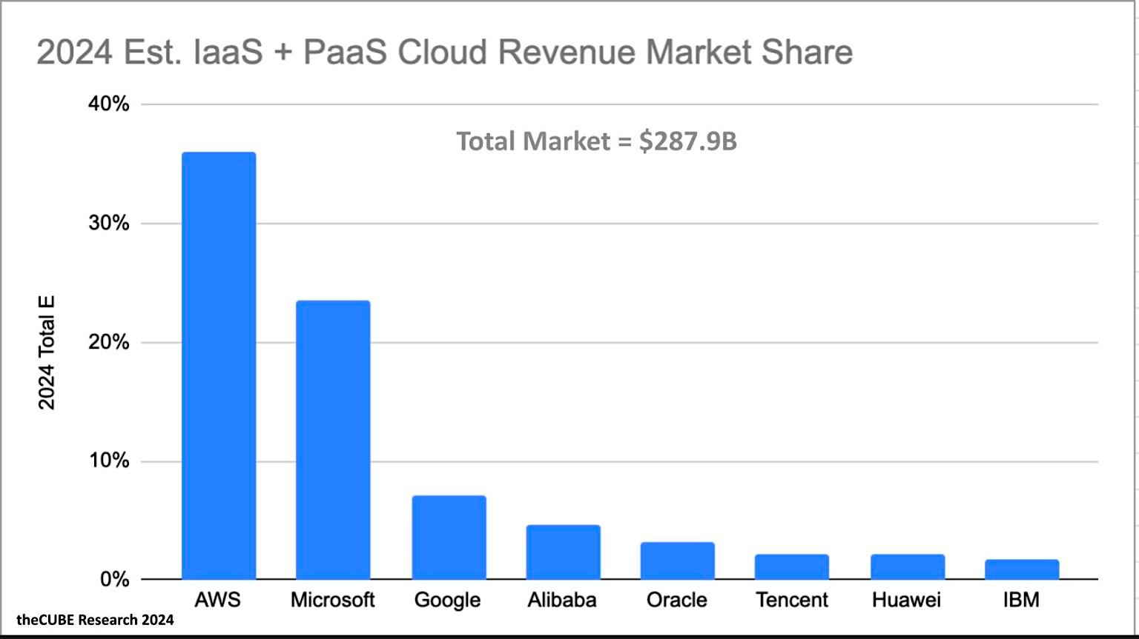
Cloud market share 2024

Slide 4
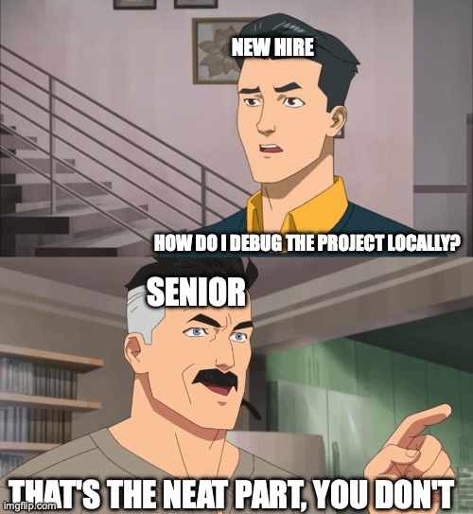
Debug AWS locally?

Slide 5
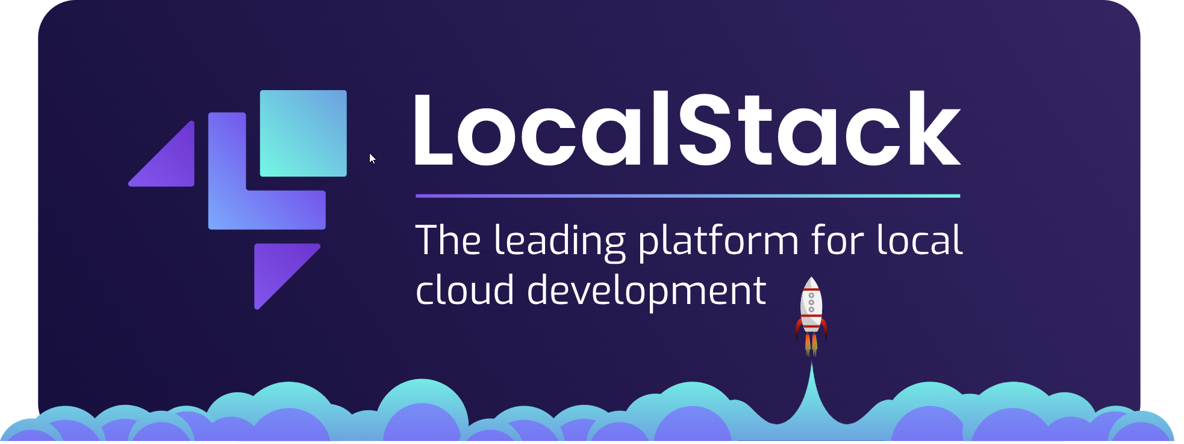
Introducing:
https://www.localstack.cloud/

Slide 6
How does it work?
A simple container that emulates AWS resources
Can be configured and started with multiple options:
Docker run command
Docker compose
Docker Extension (supported with Docker Desktop)

Slide 7

Localstack is not a mock service
The difference between mock and emulate is that mock is to mimic, to simulate while emulate is to attempt to equal or be the same as.

Slide 8
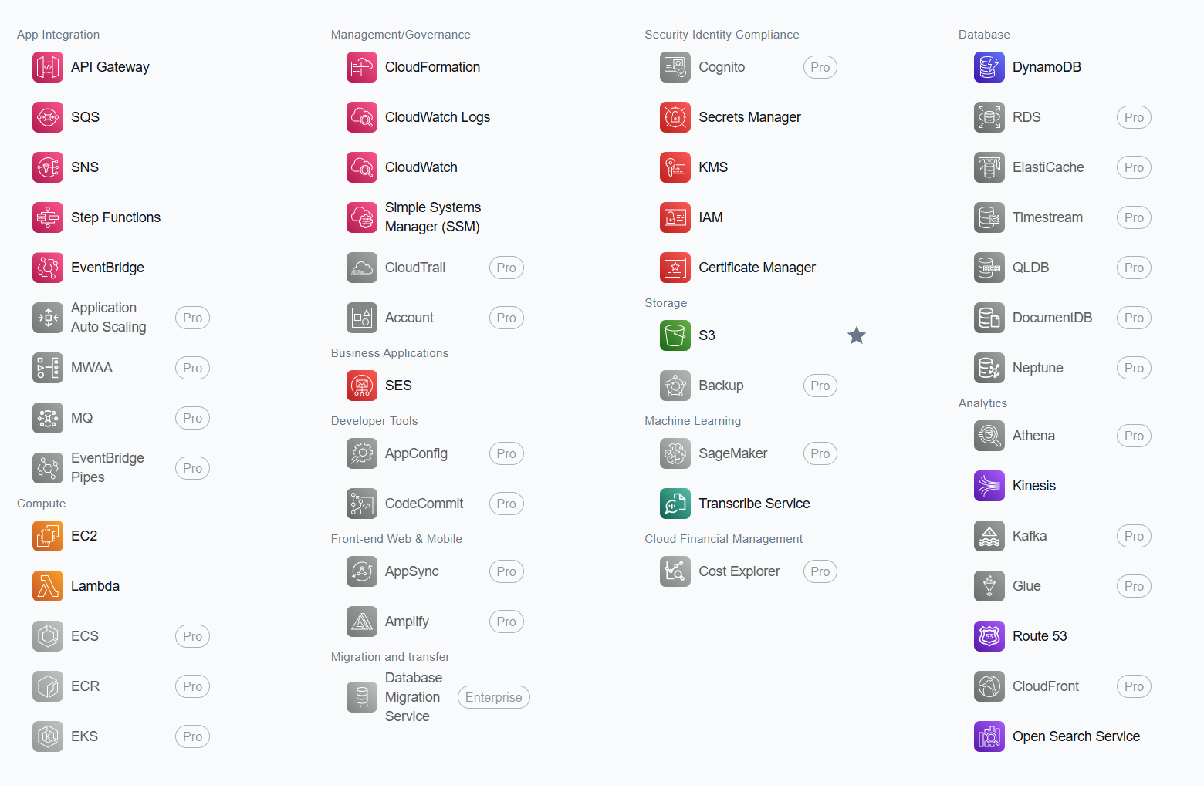
What AWS resources are supported?

Slide 9
Multiple ways of interactions
AWS CLI
AWS CDK (Code + CLI)
AWS SAM (Template + CLI)
Web API with built-in GUI support

Slide 10
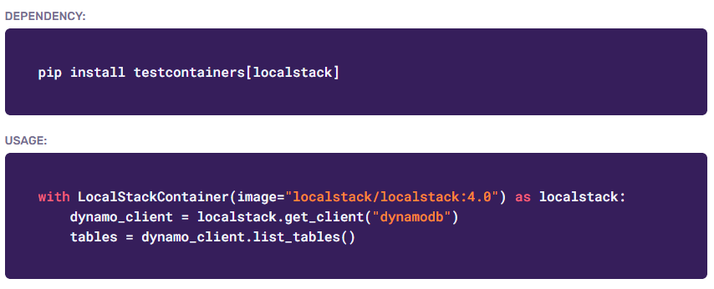
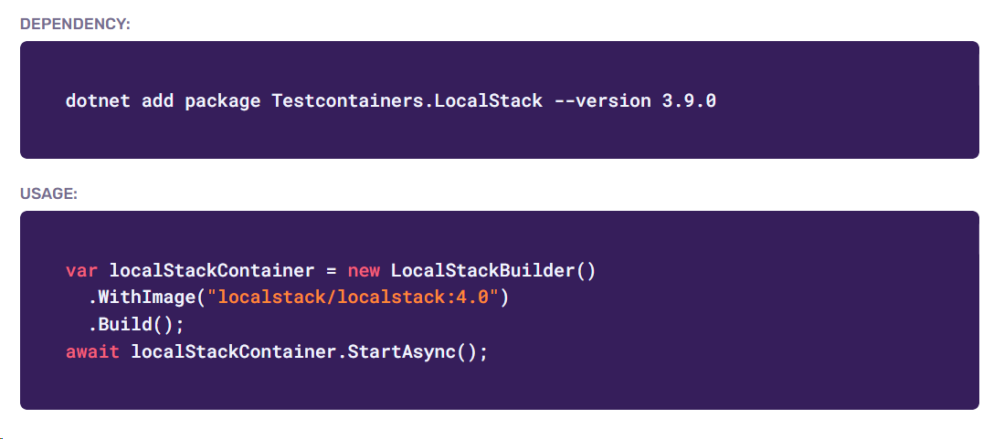
Usages
Development
Integration Tests
Compatible with “Testcontainers” with all major languages Python Dotnet

Slide 11

Demo Time!

Slide 12
Workshop!
https://github.com/omri-ratson/localstack-dotnet-demo

Slide 14
Questions?
Q & A

